Slide 1



Done By:
Arwa Doha – 1190324
Karmel Aqqad - 1191379
Kamilia Aqqad - 1191384
Strategies for Precision in
Clock Generation

Slide 2
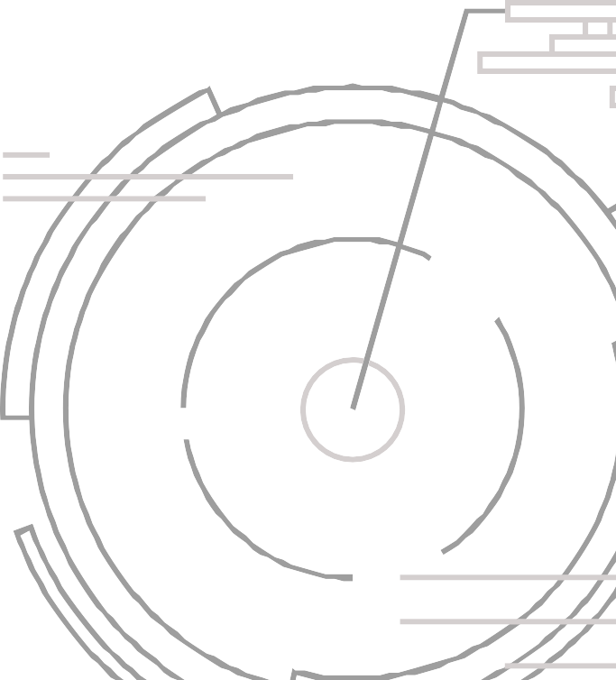
Introduction
In today's highly interconnected and technology-driven world, precise timing and clock signals are critical for the functioning of electronic systems.
Challenges arise as semiconductor technology advances, introducing new processes, materials, and design constraints.
Clock uncertainty, characterized by jitter and skew, can impact the performance and power efficiency of digital systems.

Slide 3

Clock Uncertainty
Definition: Clock uncertainty is the combination of jitter and skew.
Jitter refers to short-term irregularities, while skew represents long-term timing discrepancies.
Causes: Process variations, temperature fluctuations, voltage modifications, and electromagnetic interference.

Slide 4
Importance of Precision in Clock Generation
Precision and reliability in clock generation processes are crucial for reducing clock uncertainty.
Factors affecting precision: Process variations, temperature, voltage, and electromagnetic interference.

Slide 5
Clock Generation Techniques

Slide 6
Traditional Clock Generation Techniques
This methods worked well in earlier semiconductor processes.
To provide clock signals, these techniques used straightforward phase-locked loops (PLLs) and delay-locked loops (DLLs).
These methods might not offer the level of precision needed in sophisticated operations, even though they still have their place in some applications.

Slide 7




2. Advanced Clock Generation Techniques:
All-Digital Phase-Locked Loops (ADPLLs):
ADPLLs are a more recent method of clock generating that uses digital control loops to produce very accurate and adaptable clocks.
They are suitable for modern semiconductor processes because they offer upgraded immunity to process fluctuations and environmental influences.
They can adjust to changes in conditions and real-time-optimize clock signals.

Slide 8
2. Advanced Clock Generation Techniques:
Ring Oscillators and Oscillator Arrays:
These clock generation devices offer a compact and low-power alternative.
Compared to traditional oscillators, they are less sensitive to environmental changes and may be adjusted to provide precise frequencies.

Slide 9
2. Advanced Clock Generation Techniques:
Fractional-N PLLs:
These PLLs enables the generation of non-integer clock frequencies.
That flexibility is crucial for tailoring clock signals to particular system needs while reducing jitter.

Slide 10
Minimizing Clock Uncertainty for Different Process Technologies
Post-Processing Techniques
Use On-Chip Sensors
Customize Clock Generation
Plan for Process Variations

Slide 11
1. Plan for Process Variations
Recognize that with modern semiconductor technologies, process variations increase clock uncertainty.
Create clock generating circuits that are more resistant to these changes.
This might need considerable testing, adaptive adjusting, or redundancy.

Slide 12
2. Use On-Chip Sensors:
On-chip sensors may be used to continuously track changes in temperature, voltage, and process.
These sensors can provide information to clock generating circuits, enabling them to dynamically modify the clock to reduce uncertainty.

Slide 13
3. Customize Clock Generation:
Adapt clock generating circuits to the particular needs of the intended application.
This may involve implementing several clock generating strategies for various system components, such as
high-precision ADPLLs in crucial regions and less crucial oscillators away.

Slide 14
4. Post-Processing Techniques
Use post-processing strategies to further minimize clock uncertainty at the system level.
This includes clock domain crossing synchronization and clock skew reduction methods.

Slide 15
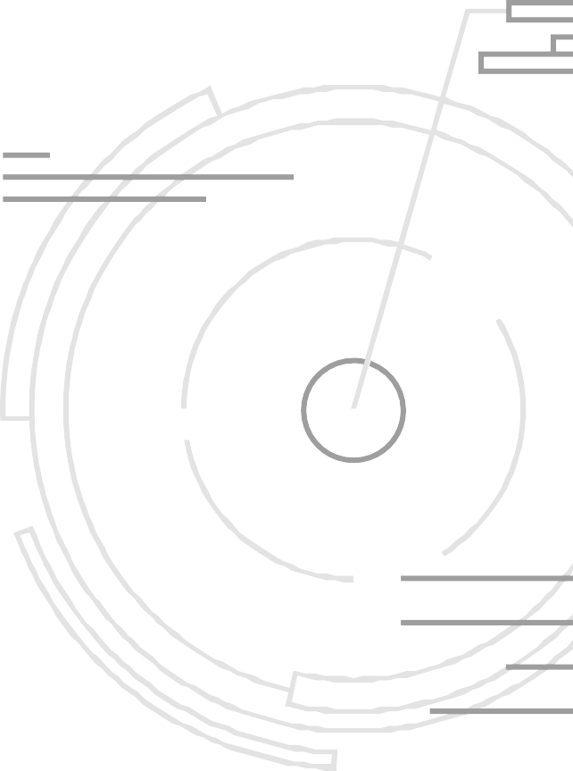
In Conclusion
Minimizing clock uncertainty has grown to be a difficult task in the semiconductor industry, which is continually growing.
Innovative clock generating techniques are required by many process technologies in order to keep up with the growing complexity and unpredictability of contemporary digital systems.
To provide accurate and dependable clock signals, sophisticated methods such as ADPLLs, ring oscillators, and fractional-N PLLs are required, along with proactive measures to reduce the impacts of process fluctuations.
Designing high-performance, low-power electronic systems will
continue to depend heavily on the capacity to reduce clock
uncertainty as semiconductor technology develops.

Slide 16
THANK YOU

